Slide 1

ICT504 IT Strategy & Leadership Week 5 Innovation Lecturer: Dr. Farshid Keivanian

Slide 2
Lecture Outline
Digital Business Innovation.
The ‘push’ and ‘pull’ of Innovating with ICT.
Getting Management Attention for Ideas and Innovations.
The Big Data Challenge.
Discovering Strategic ICT Opportunities from Information.
Building an Analytic Capability.

Slide 3
Digital Innovation – A Step-by-Step Journey
Digital innovation means bringing new technology ideas into real practice. It follows 6 steps:
Awareness: Spotting a need or opportunity (e.g., how remote work became a need during COVID).
Generation: Thinking of or discovering new tech (e.g., MyGovID for secure access).

Slide 4
Digital Innovation – A Step-by-Step Journey
Evaluation: Checking if the tech fits business goals (e.g., AI for traffic flow in Sydney).
Selection: Keep or drop the idea.
Implementation: Start using it (e.g., Coles using smart checkout).
Assimilation: Making it a part of daily work.

Slide 5
Digital Innovation – A Step-by-Step Journey
Analogy: Like building a house—you don’t just start hammering. You plan, select materials, build, and move in.

Slide 6
Open vs Closed Innovation
Closed Innovation: Innovation done internally (e.g., CSIRO tech development).
Open Innovation: Involve others outside your company (e.g., Atlassian's hackathons, or NSW Gov’s open data for app developers).
Analogy: Closed innovation is cooking alone. Open innovation is a potluck—everyone brings ideas.

Slide 7
Open vs Closed Innovation
Feature | Closed Innovation | Open Innovation
Who innovates? | Internal teams | Internal + external people
Speed | Slower | Faster
Risk | Controlled | Shared
Example in AU | CSIRO lab work | GovHack competition

Slide 8
Pull vs Push Innovation
Pull: Innovation pulled from internal needs/customers (e.g., Woolworths Scan&Go due to customer feedback).
Push: Innovation pushed from outside (e.g., Tesla pushing EV tech, now used by QLD gov).

Slide 9
Pull vs Push Innovation
Analogy:
Pull: You ask for a new laptop.
Push: Someone gives you a new laptop before you ask.

Slide 10
Disruptive Innovation
Disruptive innovation changes everything!
It doesn’t follow old rules (e.g., Airbnb disrupted hotels in Australia).
Starts small but grows fast (e.g., Afterpay changed how Aussies pay).
Analogy: Like Uber showing up in a city with no taxis ready—chaos at first, then change.

Slide 11
Activities & Questions
Digital Innovation
Discussion Prompt: "Which step of digital innovation is most challenging in Australian universities?"
Sample Answer: Implementation—slow due to budget and resistance to change.
Hands-on: Map a real digital innovation (like Service NSW App) to the 6-step model.
Problem-Solving: "A uni library wants to use AR to guide students—what steps should they follow?"

Slide 12
Activities & Questions
Role Play Debate: "Should universities prioritize innovation over tradition?"

Slide 13
Open vs Closed Innovation
Discussion Prompt: "Should the government open-source its COVID contact tracing code?"
Sample Answer: Yes—it promotes transparency and invites better ideas.
Hands-on: Compare two Australian innovations—one open (like COVIDSafe app development) and one closed (like Telstra’s 5G rollout).

Slide 14
Open vs Closed Innovation
Problem-Solving: “What happens if Coles opens its customer innovation platform?”
Role Play Debate: "You’re CEO—will you adopt open or closed innovation? Defend your strategy."

Slide 15
Pull vs Push Innovation
Discussion Prompt: "Should innovation always respond to customer demand?"
Sample Answer: Not always—sometimes they don’t know what’s possible.
Hands-on: Identify two real AU businesses using Pull (e.g., Commonwealth Bank) and Push (e.g., Tesla in AU).

Slide 16
Pull vs Push Innovation
Problem-Solving: “How can TAFE NSW balance both push and pull innovation?”
Role Play Debate: “Your startup created a new payment system—will you push it or wait for pull?”

Slide 17
Disruptive Innovation
Discussion Prompt: "Is Uber good or bad for Sydney’s transport ecosystem?"
Sample Answer: Good for choice, bad for traditional taxis.
Hands-on: Timeline of disruption: pick one (e.g., streaming vs free-to-air TV in Australia).

Slide 18
Disruptive Innovation
Problem-Solving: “How can traditional banks react to Afterpay's disruption?”
Role Play Debate: “You run a university—do you fight or adopt online microcredentials?”

Slide 19
Search for Ideas
Searching for innovation starts with understanding:
The business problem or need (e.g., NDIS digital portal improvements)
The people involved (e.g., healthcare workers using My Health Record)
The information available
Available technologies (e.g., AI, IoT in aged care)
Comparing Push vs Pull ideas

Slide 20
Search for Ideas
Getting support from leadership
Analogy: Like planning a new café—you need to know the location, customer needs, what tech (POS, app) to use, and get investors onboard.

Slide 21
Exploration vs Exploitation
Two different innovation goals:
Exploration: Try new things, gather insights (e.g., Woolworths testing AI cameras)
Exploitation: Improve what’s already working (e.g., Coles optimizing delivery)

Slide 22
Exploration vs Exploitation
Factor | Exploration | Exploitation
Purpose | Learn & discover | Improve & optimize
Risk Level | Higher | Lower
Example (AU) | Telstra 5G Labs in Melbourne | Medicare processing system tweaks

Slide 23
Exploration vs Exploitation
Analogy: Exploration is loking for a new planet. Exploitation is building better roads on Earth.

Slide 24
Big Data Challenge
More data = better decisions, right? Not always!
Problem: Data is everywhere (structured, unstructured)
Solution: Turn data into insights (e.g., NSW Government open data sets)
Challenge: It’s a business issue, not just IT
ICT Tools: Help process it (e.g., using Tableau or Power BI)

Slide 25
Big Data Challenge
Analogy: Having more ingredients doesn’t mean you can cook. You need a recipe—data tools give you that recipe.

Slide 26
Student Engagement Activities
Search for Ideas
Discussion: "What’s harder—finding ideas or convincing managers to adopt them?"
Sample Answer: Convincing is harder; ideas often exist but lack support.

Slide 27
Student Engagement Activities
Hands-on: Students brainstorm an idea for local councils using AI (e.g., waste tracking).
Problem-solving: “How would you gather info for a university mobile app idea?”
Role-play Debate: "You’re pitching a drone delivery idea to Woolworths—convince your skeptical board."

Slide 28
Exploration vs Exploitation
Discussion: “Should government agencies focus more on exploring or exploiting tech?”
Sample Answer: A mix—explore for better public services, exploit to reduce costs.
Hands-on: Identify if these are Exploration or Exploitation:

Slide 29
Exploration vs Exploitation
Qantas investing in SAF (Exploration)
MyGov app bug fix (Exploitation)
Problem-solving: “How can ACU use exploration to improve online teaching?”
Role-play Debate: "You're CIO. Your team wants to explore VR teaching—approve it or not?"

Slide 30
Big Data Challenge
Discussion: "Does more data always mean better decisions?"
Sample Answer: Not if it’s messy. Clean + relevant data matters more.
Hands-on: Use Power BI to visualize data from data.gov.au.

Slide 31
Big Data Challenge
Problem-solving: “Your business gets social media, sales, and GPS data—how do you process it?”
Role-play Debate: “As a manager, should you rely on AI data analysis or human intuition?”

Slide 32
Discovery of New Knowledge
Discovering new knowledge means asking the right questions using data. Sometimes:
You already have questions (e.g., "Why are customers leaving?")
Sometimes data reveals questions you didn’t think to ask (e.g., "Why did users from Melbourne suddenly stop using the app last week?")

Slide 33
Discovery of New Knowledge
Analogy: Like opening a fridge and realizing there’s enough to make a surprise dish—you just didn’t know it until you looked deeper.
🇦🇺 Example (Australia):
Woolworths using customer purchase data to adjust weekly discounts.
The ATO using patterns to flag unusual refund claims.

Slide 34
Building Analytic Capabilities
Analytic capability = turning data into smart actions.
Manage data: Store and organize it well (e.g., using SQL databases)
Make sense of it: Use tools like Power BI, Tableau, Python
Act on it: Apply findings to change business strategy

Slide 35
Building Analytic Capabilities
Analogy: Like having a GPS in your car—it’s not just about the map, but reading it correctly and deciding when to change routes.
🇦🇺 Example:
NAB uses big data analytics to detect fraud in real time.
Westfield optimizes mall layouts based on shopper movement data.

Slide 36
Comparison Table (Combined Concept)
Feature | Discovery of Knowledge | Analytic Capability
Focus | Asking new/hidden questions | Acting on known insights
Tools Involved | Data mining, pattern discovery | BI dashboards, algorithms
Example in AU | MyGov user behavior analysis | Commonwealth Bank personalisation
Analogy | Fridge surprise | GPS for decisions

Slide 37
Student Engagement Activities
Discovery of New Knowledge
Discussion: "What’s an example where a business might have answers but not know the question yet?"
Sample Answer: A gym chain might have swipe-in data but never thought to ask who’s most likely to quit.
Hands-on: Given a dataset (e.g., student attendance), students generate 3 meaningful questions they didn't initially consider.

Slide 38
Student Engagement Activities
Problem-solving: “A marketing team has campaign click data—what questions should they ask that aren’t obvious?”
Role-play Debate: "Should businesses only focus on known problems or explore unexpected patterns?"

Slide 39
Building Analytic Capabilities
Discussion: “What makes a company good at using data?”
Sample Answer: Having people and systems that can turn reports into action, not just collect data.
Hands-on: Students use mock data in Excel/Power BI to generate insights and present decisions.

Slide 40
Building Analytic Capabilities
Problem-solving: “You’re a supermarket manager. You have loyalty card data—how do you improve customer retention?”
Role-play Debate: “You’re a startup—should you invest in analytics tools early, or wait until you grow?”

Slide 41
Summary
Providing innovation for business growth.
Management plays an important roles encouraging innovation.
Technology awareness.
Knowledge discovery.

Slide 42
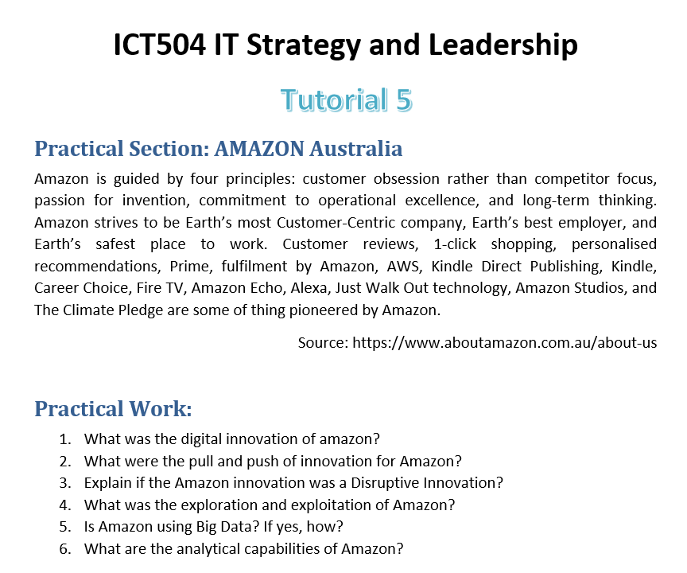
Tutorial Week 5

Slide 43

Reading Materials

Slide 44
Articles
T. Gerth and J. Peppard, ‘How newly appointed chief information officers (CIOs) take charge’, MIS Quarterly Executive, 13, 3, 2014, 159–173; and J. Peppard, ‘Unlocking the performance of the chief information officer (CIO), California Management Review, 52, 4, 2010, 73–99.
H.W. Chesbrough, Open Innovation: The New Imperative for Creating and Profiting from Technology, Boston: Harvard Business Press, 2003; and P.M. Di Gangi, M.M. Wasko and R.E. Hooker, ‘Getting ideas to work for you: learning from Dell how to succeed with online user innovation communities’, MIS Quarterly Executive, 9, 4, 2010, 213–228.
G. Loveman, ‘Diamonds in the data mine’, Harvard Business Review, May, 2003, 109–113.

